Slide 1



Cerebra Tech
4x4 training program
CODE
PORTFOLIO
Manasa P
21WU0101055
Team 3

Slide 2


about us
vision
brand
project
WELCOME TO CEREBRATECH
Empower Future Innovators
Cerebra Tech is a dynamic startup specializing in developing end-to-end projects using modern technologies.“​
"Our mission is to deliver impactful solutions while fostering a culture of innovation and continuous learning.
Training Overview:
Python Programming
Database Management
Data Analysis & Manipulation
Machine Learning Algorithms
Deep Learning
Web Development with Flask​
Deployment (CI/CD)
PAGE 02

Slide 3
PYTHON PROGRAMMING
day 1
Appointed as Cerebra Tech employees
Had an overview about python programming
Python tasks focusing on scripting, problem-solving, and logic building.
Examples include working with control structures, functions, and object-oriented programming.
Introduction, variables, datatypes, indentation, strings, lists, tuples, sets, dictionary, standard input output, operators and its types
Conditional statements (if, if-elif-else, if-else)
Loops (For, While, Do-while)
Object Programming (class, objects, encapsulation, inheritance, polymorphism)
Exception handling (try, except, finally)
File modes
2025

Slide 4

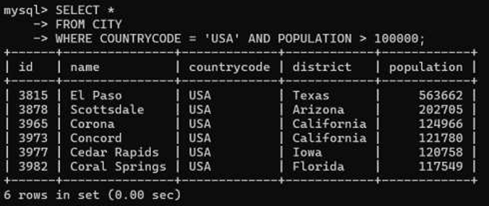
day 2
MYSQL
SQL queries to interact with relational databases.
Includes database creation, table manipulation, and advanced queries.
50 SQL Challenges were given to code and submit using Github
2025
PAGE 04

Slide 5
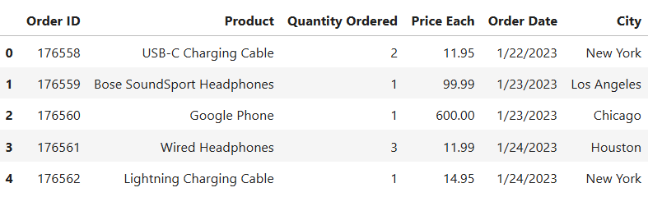
day 3
PANDAS
Data manipulation and analysis in Python.
Data Structures: Series and DataFrame objects for handling 1D and 2D data.
Data Manipulation:
Importing/exporting data from various formats (CSV, Excel, JSON).
Filtering, sorting, and aggregating data.
Handling missing values.
2025
PAGE 08

Slide 6

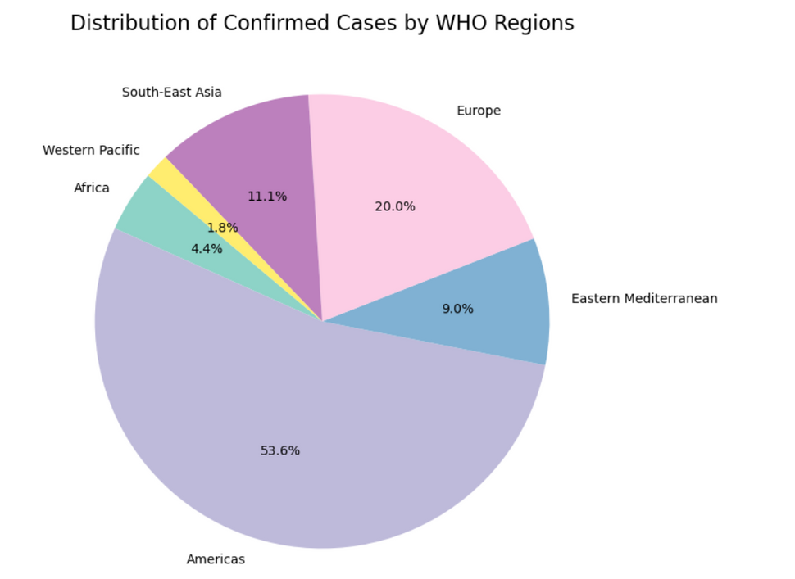
EXPLORATORY DATA ANALYSIS
Dataset: COVID-19
Provide an overview of the COVID-19 pandemic's global impact.
Highlight significant trends and patterns using visualizations.
Offer insights that can inform further research or decision-making.
Insights Derived
1. Top 10 Countries by Confirmed Cases
Countries like USA, India, Brazil, and Russia have the highest confirmed cases.
2. Distribution of Confirmed Cases by WHO Regions
Americas and Europe account for the largest share of cases.
3. Relationship Between Active Cases and Death Percentage
No strong correlation was observed between active cases and death rates.

Slide 7


MACHINE LEARNING
Focus: Building predictive models using datasets.
Supervised Learning:
Regression: Predicting continuous values using models like Linear Regression.
Classification: Identifying categories using algorithms like Decision Trees, Random Forests, or Logistic Regression.
Unsupervised Learning:
Clustering: Grouping data points using methods like K-Means.
Dimensionality Reduction: Techniques like PCA to reduce data complexity.
Model Evaluation:
Metrics: Accuracy, Precision, Recall, F1-score, RMSE.
Validation: Train-test splits and cross-validation techniques.
Model Deployment:
Integration into applications.
2025

Slide 8
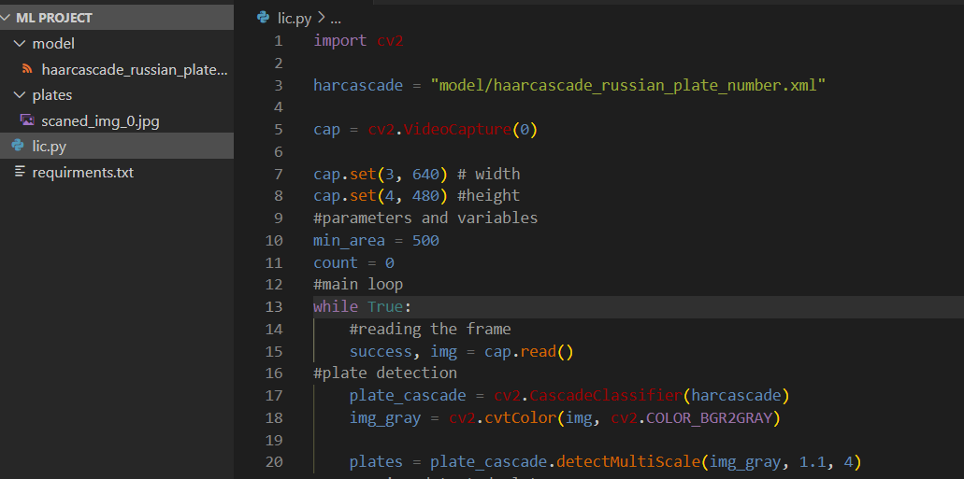
LICENSE PLATE DETECTION PROJECT
To automate the detection of vehicle license plates in real-time using computer vision techniques.
Key Features:
Detects and highlights license plates in video streams or images.
Utilizes Haar Cascade Classifier for plate recognition.
Real-time processing with OpenCV.
Tools & Technologies:
OpenCV, Python, Haar Cascade XML for plate detection
Applications:
Traffic monitoring and law enforcement
Automated toll collection systems
Parking management systems
Workflow:
Capture video feed or image.
Convert to grayscale for preprocessing.
Apply Haar Cascade to detect plates.
Display or save the extracted plate region.
Output:
Real-time detection and bounding box visualization of license plates.

Slide 9

DEEP LEARNING
day 4
The goal of this project is to classify handwritten digits (0-9) from the MNIST dataset using a CNN. The MNIST dataset is a collection of 28x28 pixel grayscale images of handwritten digits.
Data Preprocessing
Model
Training
Testing
The MNIST dataset is loaded, and the pixel values are normalized to range between 0 and 1.
Images are reshaped to have a channel dimension (28x28x1)
The model consists of several convolutional layers (Conv2D), each followed by max-pooling layers (MaxPooling2D).
The output layer is a Dense layer with 10 units and softmax activation, which is typical for multi-class classification.
The model is trained using the Adam optimizer and sparse categorical cross-entropy loss.
This works well for multi-class classification tasks.
After training, the model’s accuracy is evaluated on the test set.
Then, the model can be used to predict the class of a given image.

Slide 10
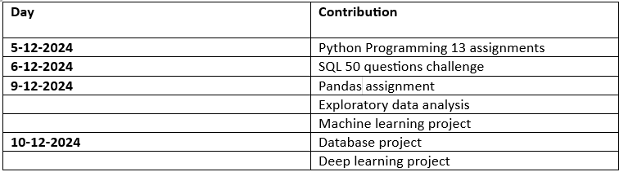
GITHUB CONTRIBUTIONS
URL: https://github.com/manasa-x/Code-Portfolio

Slide 11
THANK
YOU
2025
PAGE 10

